Slide 1
Introduction to Software Cost Estimation (Chapter 23 edit 9)
COMP SCI: Software Engineering and Project
School of Computer Science
The University of Adelaide

Slide 2





How to estimate the cost of a software project (product)?

Slide 3
Overview
Parameters and factors that influence the cost estimation
Software productivity and their measure
  Lines of code
  Function Points
  Object Points
Cost Estimation techniques
  Algorithmic cost modelling.
  Expert judgement.
  Estimation by analogy.
  Pricing to win.
Cost Estimation Model – COCOMO II

Slide 4
Fundamental Cost Estimation
Questions and Classic Cost Estimation model
How much effort is required to complete an activity?
How much calendar time is needed to complete an activity?
What is the total cost of an activity?
How to schedule and mange a software process so that the overhead cost can be controlled?

Slide 5
Software Cost Parameters
Hardware and software (used to develop the specific software product) costs.
Travel and training costs.
Effort costs (the dominant factor in most projects)
  The salaries of engineers involved in the project;
  Social and insurance costs.
Effort costs must take overheads into account
  Costs of building, heating, lighting.
  Costs of networking and communications.
  Costs of shared facilities (e.g library, staff restaurant, etc.).

Slide 6
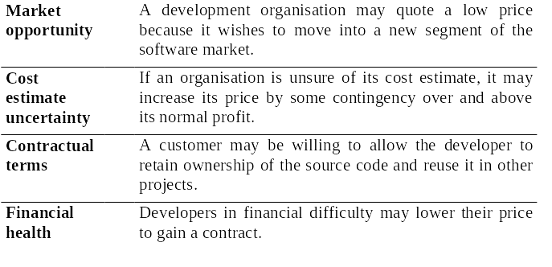
Costing and Pricing
There is not a simple relationship between the development cost and the price charged to the customer (?)
  Beside the cost related to the developers, many other factors needed to be considered, such as:

Slide 7
Software Productivity
A measure of the rate at which individual engineers involved in software development produce software and associated documentation over certain period of time.
  This measurement is to measure useful functionality produced per time unit essentially.
    e.g. 50 function points/Person Month
  This measurement is NOT quality-oriented itself although quality assurance is a factor in productivity assessment.

Slide 8
Productivity Measures
Size related measures (Lines of code)
  Based on some output from the software process.
  This may be lines of delivered source code, object code instructions, etc.
Function-related measures
  Based on an estimate of the functionality of the delivered software.
  Function-points are the best known of this type of measure.
    Function points,
    Object points

Slide 9
Estimation techniques
Organizations need to make software effort and cost estimates. There are two types of technique that can be used to do this:
  Experience-based techniques The estimate of future effort requirements is based on the manager’s experience of past projects and the application domain. Essentially, the manager makes an informed judgment of what the effort requirements are likely to be.
  Algorithmic cost modeling In this approach, a formulaic approach is used to compute the project effort based on estimates of product attributes, such as size, and process characteristics, such as experience of staff involved.

Slide 10
Experience-based approaches
Experience-based techniques rely on judgments based on experience of past projects and the effort expended in these projects on software development activities.
Typically, you identify the deliverables to be produced in a project and the different software components or systems that are to be developed.
You document these in a spreadsheet, estimate them individually and compute the total effort required.
It usually helps to get a group of people involved in the effort estimation and to ask each member of the group to explain their estimate.

Slide 11
Algorithmic cost modelling
Not often used – difficult to predict code size
Cost is estimated as a mathematical function of product, project and process attributes whose values are estimated by project managers:
  Effort = A × Size^{B} × M
  A is an organisation-dependent constant, Size is the code size/or functionality estimate expressed in function or application points
  B (usually between 1 and 1.5) reflects the disproportionate effort for large projects and M is a multiplier reflecting product, process and people attributes.
The most commonly used product attribute for cost
estimation is code size.
Most models are similar but they use different values for A, B and M.

Slide 12
Estimation accuracy
The size of a software system can only be known accurately when it is finished.
Several factors influence the final size
  Use of COTS and components;
  Programming language;
  Distribution of system.
As the development process progresses then the size estimate becomes more accurate.
The estimates of the factors contributing to B and M are subjective and vary according to the judgment of the estimator.

Slide 13
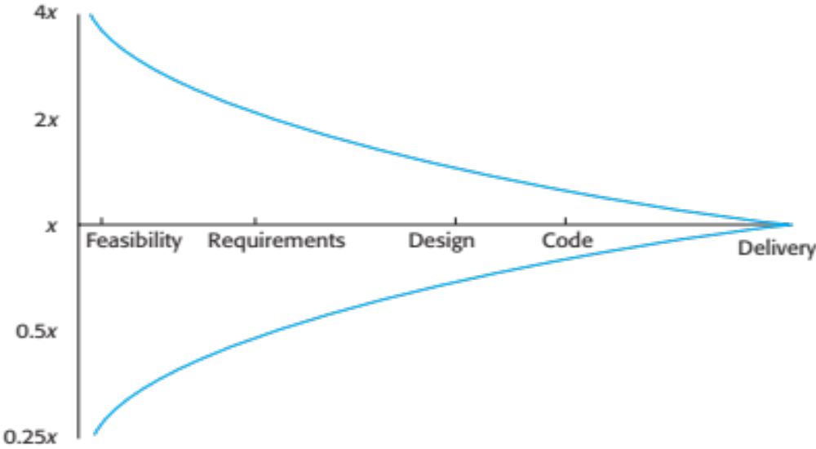
Estimate uncertainty

Slide 14
The COCOMO 2 model
An empirical model based on project experience.
Well-documented, ‘independent’ model which is not tied to a specific software vendor.
Long history from initial version published in 1981 (COCOMO-81) through various instantiations to COCOMO 2.
COCOMO 2 takes into account different approaches to software development, reuse, etc.

Slide 15
COCOMO 2 models
COCOMO 2 incorporates a range of sub-models that produce increasingly detailed software estimates.
The sub-models in COCOMO 2 are:
  Application composition model. Used when software is composed from existing parts. Strong Estimation factors.
  Early design model. Used when requirements are available but design has not yet started. After requirements have been established.
  Reuse model. Used to compute the effort of integrating reusable components. In conjunction with Post-architectural model.
  Post-architecture model. Used once the system architecture has been designed and more information about the system is available.

Slide 16
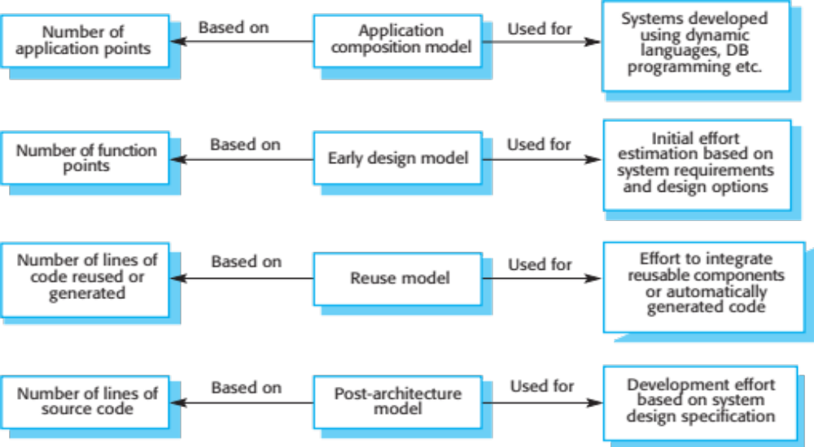
COCOMO estimation models

Slide 17
Application composition model
Supports prototyping projects and projects where there is extensive reuse.
Based on standard estimates of developer productivity in application (object) points/month.
Takes CASE tool use into account.
Formula is
  PM = ( NAP × (1 - %reuse/100 ) ) / PROD
  PM is the effort in person-months, NAP is the number of application points and PROD is the productivity.

Slide 18
Application-point productivity
Developer’s experience and capability | Very low | Low | Nominal | High | Very high
ICASE maturity and capability | Very low | Low | Nominal | High | Very high
PROD (NAP/month) | 4 | 7 | 13 | 25 | 50
A higher reading > higher influence on productivity.
High use of software tools > higher productivity.
?Are there limits in reuse?

Slide 19
Early design model
Estimates can be made after the requirements have been agreed.
Based on a standard formula for algorithmic models
  PM = A × Size^{B} × M where
  M = PERS × RCPX × RUSE × PDIF × PREX × FCIL × SCED;
    A = 2.94 in initial calibration,
    Size in KLOC,
    B varies from 1.1 to 1.24 depending on novelty of the project, development flexibility, risk management approaches and the process maturity.

Slide 20
Multipliers
Multipliers reflect the capability of the developers, the non-functional requirements, the familiarity with the development platform, etc.
  RCPX - product reliability and complexity;
  RUSE - the reuse required;
  PDIF - platform difficulty;
  PREX - personnel experience;
  PERS - personnel capability;
  SCED - required schedule;
  FCIL - the team support facilities.

Slide 21
The reuse model
Takes into account black-box code that is reused without change and code that has to be adapted to integrate it with new code.
There are two versions:
  Black-box reuse where code is not modified. An effort estimate (PM) is computed.
  White-box reuse where code is modified. A size estimate equivalent to the number of lines of new source code is computed.
  This then adjusts the size estimate for new code.

Slide 22
Reuse model estimates 1
For generated code:
  PM = (ASLOC * AT/100)/ATPROD
  ASLOC is the number of lines of generated code
  AT is the percentage of code automatically generated.
  ATPROD is the productivity of engineers in integrating this code.

Slide 23
Reuse model estimates 2
When code has to be understood and integrated:
  ESLOC = ASLOC * (1-AT/100) * AAM.
  ASLOC and AT as before.
  AAM is the adaptation adjustment multiplier computed from the costs of changing the reused code, the costs of understanding how to integrate the code and the costs of reuse decision making.
  http://www.SoftwareEingineering-9.com/Web/Planning/costdrivers.html

Slide 24
Post-architecture level
The most detailed of the COCOMO II models
Uses the same formula as the early design model:
PM = A × Size^{B} × M ,but with 17 rather than 7 associated multipliers.
The code size is estimated as:
  Number of lines of new code to be developed;
  Estimate of equivalent number of lines of new code computed using the reuse model;
  An estimate of the number of lines of code that have to be modified according to requirements changes.

Slide 25
The exponent term
This depends on 5 scale factors (see next slide).
Their sum/100 is added to 1.01 to get the exponent (B-value)
A company takes on a project in a new domain. The client has not defined the process to be used and has not allowed time for risk analysis. The company has a CMM level 2 rating.
  Precedenteness - new project (4)
  Development flexibility - no client involvement - Very high (1)
  Architecture/risk resolution - No risk analysis - V. Low .(5)
  Team cohesion - new team - nominal (3)
  Process maturity - some control - nominal (3)
Scale factor is therefore 1.17. (sum 16 /100+0.01)

Slide 26
Scale factors used in the exponent computation in the post-architecture model
Note, values: 0 –> extra high, 5 ->very low
Scale factor | Explanation
Precedentedness | Reflects the previous experience of the organization with this type of project. Very low means no previous experience; extra-high means that the organization is completely familiar with this application domain.
Development flexibility | Reflects the degree of flexibility in the development process. Very low means a prescribed process is used; extra-high means that the client sets only general goals.
Architecture/risk resolution | Reflects the extent of risk analysis carried out. Very low means little analysis; extra-high means a complete and thorough risk analysis.
Team cohesion | Reflects how well the development team knows each other and work together. Very low means very difficult interactions; extra-high means an integrated and effective team with no communication problems.
Process maturity | Reflects the process maturity of the organization. The computation of this value depends on the CMM Maturity Questionnaire, but an estimate can be achieved by subtracting the CMM process maturity level from 5.

Slide 27
Multipliers
Product attributes
  Concerned with required characteristics of the software product being developed.
Computer attributes
  Constraints imposed on the software by the hardware platform.
Personnel attributes
  Multipliers that take the experience and capabilities of the people working on the project into account.
Project attributes
  Concerned with the particular characteristics of the software development project.

Slide 28
The effect of cost drivers on effort estimates
Values from COCOMO II ref manual
Exponent value | 1.17
System size (including factors for reuse and requirements volatility) | 128,000 DSI
Initial COCOMO estimate without cost drivers | 730 person-months
Reliability | Very high, multiplier = 1.39
Complexity | Very high, multiplier = 1.3
Memory constraint | High, multiplier = 1.21
Tool use | Low, multiplier = 1.12
Schedule | Accelerated, multiplier = 1.29
Adjusted COCOMO estimate | 2,306 person-months
May take up to three times longer to complete and same project – costs…

Slide 29
The effect of cost drivers on effort estimates
Exponent value | 1.17
Reliability | Very low, multiplier = 0.75
Complexity | Very low, multiplier = 0.75
Memory constraint | None, multiplier = 1
Tool use | Very high, multiplier = 0.72
Schedule | Normal, multiplier = 1
Adjusted COCOMO estimate | 295 person-months

Slide 30
Project duration and staffing
As well as effort estimation, managers must estimate the calendar time required to complete a project and when staff will be required.
Calendar time can be estimated using a COCOMO 2 formula
  TDEV = 3 × (PM)^{(0.33+0.2*(B-1.01))}
  PM is the effort computation and B is the exponent computed as discussed above (B is 1 for the early prototyping model).
  This computation predicts the nominal schedule for the project.
The time required is independent of the number of people working on the project.

Slide 31
Staffing requirements
Staff required can’t be computed by diving the development time by the required schedule.
The number of people working on a project varies depending on the phase of the project.
The more people who work on the project, the more total effort is usually required.
A very rapid build-up of people often correlates with schedule slippage.

Slide 32
Key points 1
Estimation techniques for software may be experience-based, where managers judge the effort required, or algorithmic, where the effort required is computed from other estimated project parameters.
The COCOMO II costing model is an algorithmic cost model that uses project, product, hardware and personnel attributes as well as product size and complexity attributes to derive a cost estimate.

Slide 33
Key points 2
There is not a simple relationship between the price charged for a system and its development costs.
Factors affecting productivity include individual aptitude, domain experience, the development project, the project size, tool support and the working environment.
Software may be priced to gain a contract and the functionality adjusted to the price.

Slide 34
Key points 3
Different techniques of cost estimation should be used when estimating costs.
The COCOMO model takes project, product, personnel and hardware attributes into account when predicting effort required.
Algorithmic cost models support quantitative option analysis as they allow the costs of different options to be compared.
The time to complete a project is not proportional to the number of people working on the project.

Slide 35
Relevance to Your Project
In project:
  How do you estimate your cost of the software product.
    What techniques have you used in your project
In report:
  Tell the truth
  Justify your claim

Slide 36
Applied – from here, on your own, look at examples and research more on this.

Slide 37
Measurement Problems
Estimating the size of the measure
  e.g. how many function points or lines of code.
Estimating the total number of programmer months that have elapsed.
  Some problems with this.
    e.g. what if the programmer in extreme bad mood in a certain month
Estimating contractor productivity
  e.g. if there needs a documentation team, you need to incorporate this into overall estimation.

Slide 38
Lines of Code
What's a line of code?
  The measure was first proposed when programs were typed on cards with one line per card;
Problem with this method:
  Hard to map to the statements in different language:
    A statement in C, or Java, or C++ can be several statements in Assembly language will not be the same.
  What programs should be counted as part of the system?
  This model assumes that there is a linear relationship between system size and volume of documentation.
  Measures of productivity based on lines of code suggest that programmers who write verbose code are more productive than programmers who write compact code

Slide 39
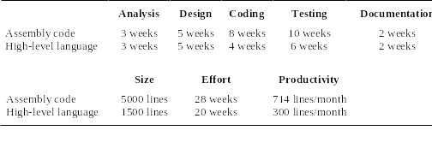
An Example of Productivity Calculation With Lines of Code
There is a System Development Time as illustrated below:

Slide 40
Estimation Techniques
There is no simple way to make an accurate estimate of the effort required to develop a software system
  Initial estimates are based on inadequate information in a user requirements definition;
  The software may run on unfamiliar computers or use new technology;
  The people in the project may be unknown.
Changing technologies may influence the technique used for estimation of the cost
  Mean that previous estimating experience does not carry over to new systems, e.g.
    Distributed object systems rather than systems;
    Use of web services; mainframe
    Use of ERP or database-centred systems;
    Use of off-the-shelf software;
Project cost estimates may be self-fulfilling
  The estimate defines the budget
  The product is adjusted to meet the budget.

Slide 41
Estimation Techniques
Algorithmic cost modelling.
Expert judgement.
Estimation by analogy.
Parkinson's Law.
Pricing to win.

Slide 42
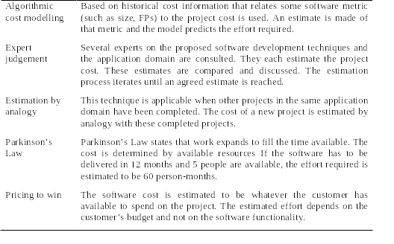
Estimation Techniques

Slide 43
Function Points
Based on a combination of program characteristics (elements)
  Number of external inputs and outputs;
  Number of user interactions (Number of external inquiries );
  Number of external interfaces;
  Number of files used by the system.
Steps in calculation
  Calculating an Unadjusted Function point Count (UFC).
  Multiplying the UFC by a Technical Complexity Factor (TCF).
    The final (adjusted) Function Point is:
  FP = UFC × TCF
A weight is associated with each of element given above

Slide 44
Object Points
Object points (alternatively named application points)
  are an alternative function-related measure to function points when 4Gls or similar languages are used for development.
Object points are NOT the same as object classes.
The number of object points in a program is a weighted estimate of
  The number of separate screens that are displayed;
  The number of reports that are produced by the system;
  The number of program modules
    Such as number of program modules that must be developed to supplement the database programming code;

Slide 45
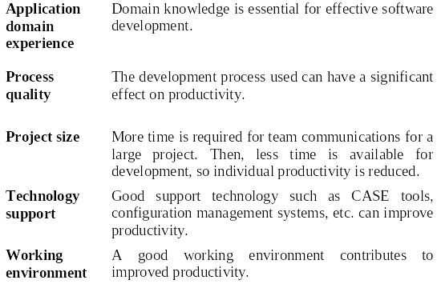
Factors Affecting Productivity

Slide 46
Function-Oriented Metrics
Functionality is another attribute of software size. The idea is that a product with more functionality will be larger in size.
Function-oriented metrics are indirect measures of software which focus on functionality and utility.
The first function-oriented metrics was proposed by Albrecht (1979~1983) who suggested a productivity measurement approach called the Function Point (FP) method.
Function points (FPs) measure the amount of functionality in a system based upon the system specification.
Estimation before implementation!

Slide 47

Function Point (FP) /1
External
inputs
External
outputs
Inputs
Outputs
Function
Point (FP)
Data Objects
Processes
Data
Inquiries
Internal Files
External Interface Files

Slide 48
Function Point (FP) /2
Function Point (FP) is a weighted measure of software functionality.
FP is computed in two steps:
  Calculating an Unadjusted Function point Count (UFC).
  Multiplying the UFC by a Technical Complexity Factor (TCF).
The final (adjusted) Function Point is:
FP = UFC × TCF

Slide 49
Function Point (FP) /3
Counts are made for the following categories:
  Number of external inputs (Ni): Those items provided by the user that describe distinct application-oriented data, control information (such as file names and menu selections), or outputs of other systems that enter an application and change the status of its internal logical file(s).
  Number of external outputs (No): All unique data or control information produced by the software systems, e.g., reports and messages.

Slide 50
Function Point (FP) /4
Counts are made for the following categories:
  Number of external inquiries (Nq): All unique input/output combinations, where an input causes and generates an immediate output without changing any status of internal logical files.
  Number of external interface files (Nef): A group of data or control information passed or shared between applications, i.e., machine-readable interfaces to other systems and/or the user.
  Number of internal files (Nif): A group of data or control information that is generated, used or maintained by the software system.

Slide 51
Tech. Complexity Factor (TCF) /1
Technical Complexity Factor (TCF) is a weighted sum of 14 components, given below:
F1 | Reliable back-up and recovery | F2 | Data communications
F3 | Distributed functions | F4 | Performance
F5 | Heavily used configuration | F6 | Online data entry
F7 | Operational ease | F8 | Online update
F9 | Complex interface | F10 | Complex processing
F11 | Reusability | F12 | Installation ease
F13 | Multiple sites | F14 | Facilitate change

Slide 52
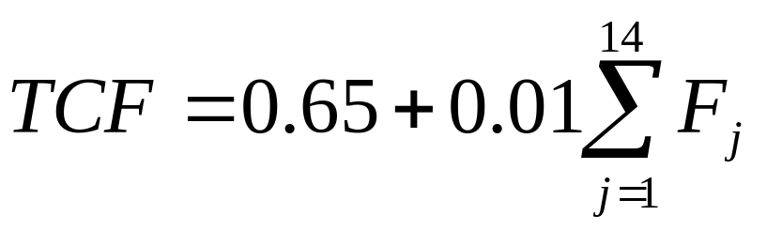
Tech. Complexity Factor (TCF) /2
Each component is rated from 0 to 5, where 0 means the component is not relevant to the system and 5 means the component is essential.
The TCF can then be calculated as:
The TCF varies from 0.65 (if all Fj are set to 0) to 1.35 (if all Fj are set to 5)

Slide 53
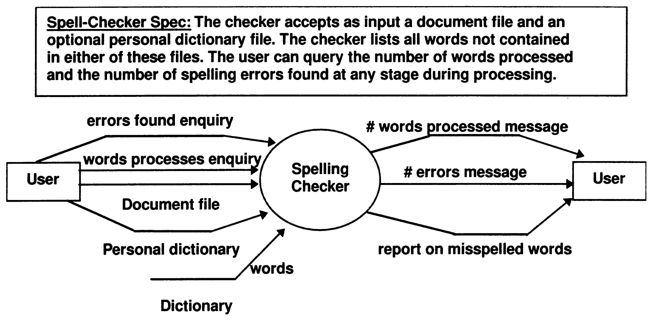
FP: Example /1
Inquiries
Inputs
Output
Messages
External file
Internal file

Slide 54
FP: Example /1 (cont’d)
Ni=2 (external inputs): document filename, personal dictionary-name
No=3 (external outputs): misspelled word report, number-of-words-processed message, number-of-errors-so-far message
Nq=2 (external inquiries): words processed, errors so far
Nef=2 (external files): document file, personal dictionary
Nif=1 (internal file): dictionary
UFC = 4×2 + 5×3 + 4×2 + 10×2 + 7×1 = 58
Suppose that
F1=F2=F6=F7=F8=F14= 3; F4=F10=5 and the rest are zero.
TCF = 0.65 + 0.01(18+10) + 0.93
FP = 58 × 0.93 ≈ 54

Slide 55
FP: Example /2
Consider the following system that processes various commands from the operator of a chemical plant. Various interactions of the system with the operator and internal and external files and systems are required

Slide 56
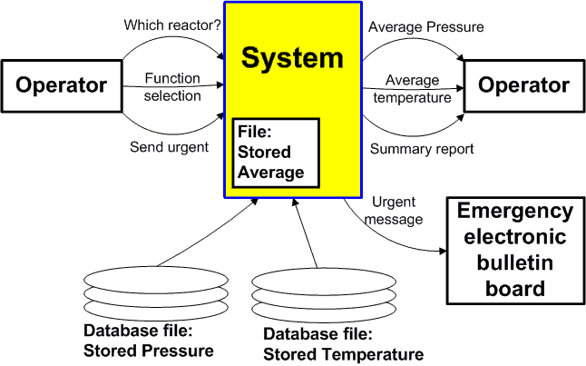
FP: Example /2 (cont’d)

Slide 57
FP: Example /2 (cont’d)
The system consults two databases for stored pressure and temperature. In the case of emergency, the system asks the user whether to send the results to an electronic emergency bulletin board or not.
Calculate the unadjusted function point count (UFC) for this system.

Slide 58
FP: Example /2 (cont’d)
Ni number of external inputs 5
No number of external outputs 4
Nq number of external inquiries 3
Nef number of external interface files 3
Nif number of internal files 1
UFC = 4x5 + 5x4 + 4x3 + 10x3 + 7x1 = 89

Slide 59
FP: Critics
FP is a subjective measure: affected by the selection of weights by external users.
Function point calculation requires a full software system specification. It is therefore difficult to use function points early in the software development lifecycle.
Physical meaning of the basic unit of FP is unclear.
Unable to account for new versions of I/O, such as data streams.
Not suitable for “complex” software, e.g., real-time and embedded applications.

Slide 60
Critical Points For Cost Estimation
Different techniques of cost estimation should be used when estimating costs.
The COCOMO model takes project, product, personnel and hardware attributes into account when predicting effort required.
Algorithmic cost models support quantitative option analysis as they allow the costs of different options to be compared.
The time to complete a project is not proportional to the number of people working on the project.

Slide 61
Critical Points For Cost Estimation
There is not a simple relationship between the price charged for a system and its development costs.
Factors affecting productivity include individual aptitude, domain experience, the development project, the project size, tool support and the working environment.
Software may be priced to gain a contract and the functionality adjusted to the price.

